Slide 1
TiGL Workshop
Curve Network Interpolation with Gordon Surfaces
12.09.2018
Merlin Pelz
System Dynamics and Control | SR-FLS
DLR Oberpfaffenhofen

Slide 2
Curve Network Interpolation with Gordon Surfaces

Slide 3
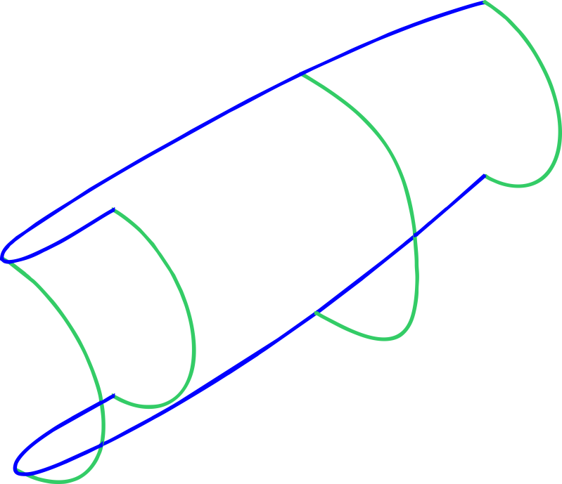
The Curve Network Interpolation Problem
Definition of the problem:
Given a network of profile and guide curves, find surface(s) which interpolate(s) these curves
profiles
guides
example of a curve network

Slide 4
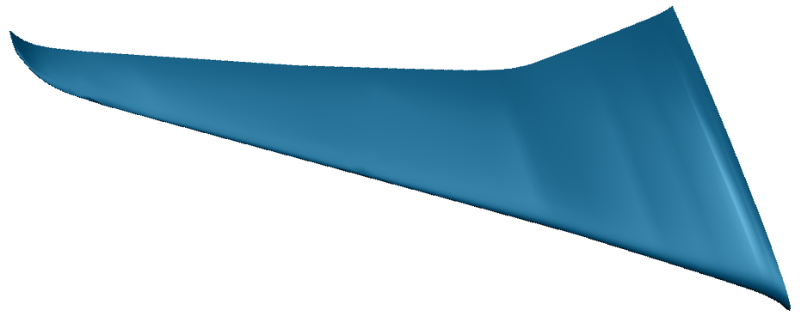
Why Gordon Surfaces? Problems with Old Method
In Digital-X, Open CASCADE was contracted for the implementation of this algorithm (based on Coons Patches)
Problems from aero simulations:
Pressure oscillations on the wing
Surface modelling probably the issue!
Analysis:
Generated surfaces have small bumps, waves and kinks
The latter is caused by C1 or C2 discontinuities on the surface
Conclusion:
Must implement a better algorithm by our own: Gordon Surfaces

Slide 5
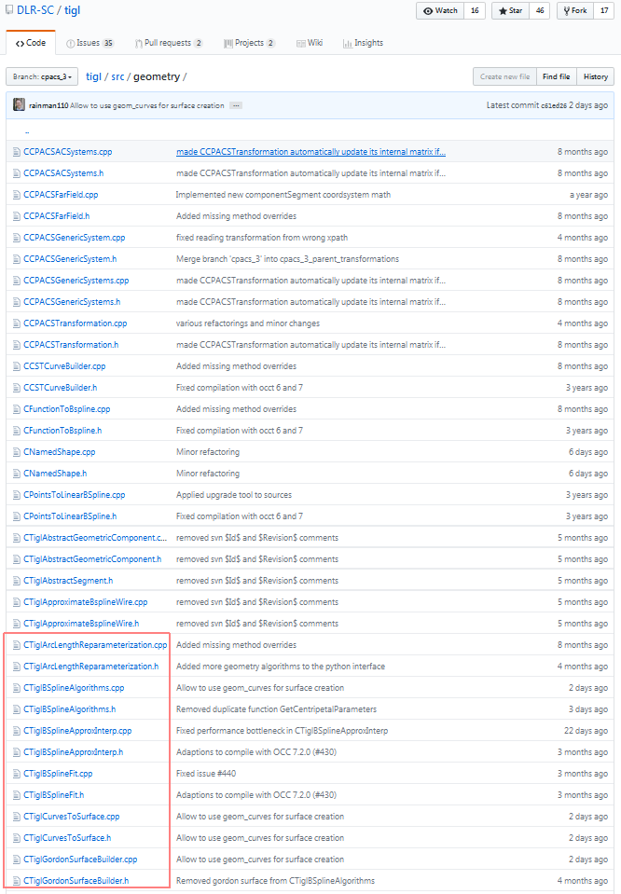

Slide 6
B-splines

Slide 7
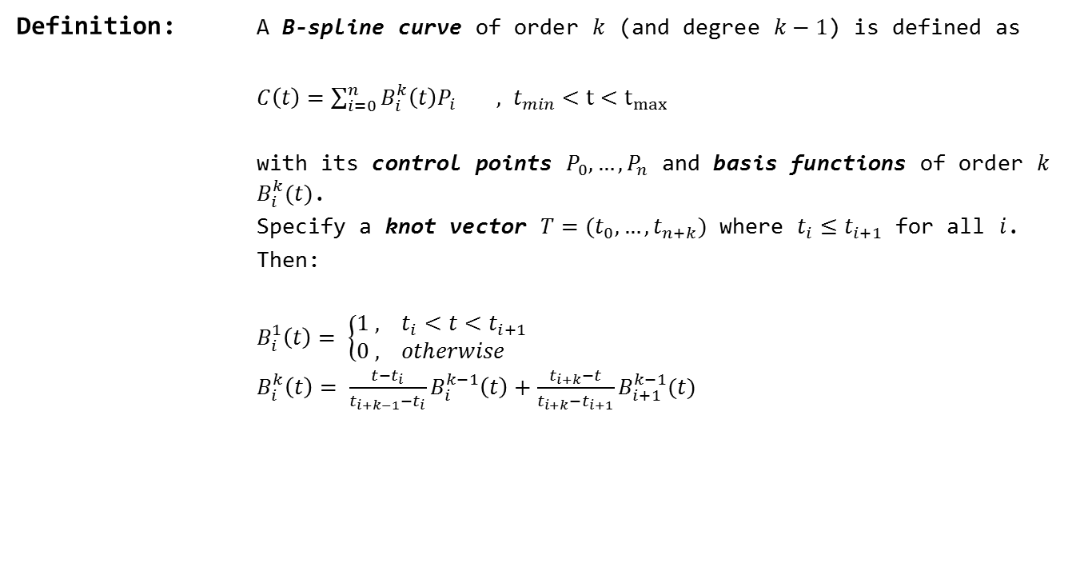
B-splines
Definition: A B-spline curve of order $k$ (and degree $k−1$) is defined as
$C\left(t\right)=\sum_{i=0}^{n}{B_{i}^{k}\left(t\right)P_{i}}$ $, t_{min}<t<t_{max}$
with its control points $P_{0},…, P_{n}$ and basis functions of order $k$ $B_{i}^{k}(t)$.
Specify a knot vector $T=(t_{0},…,t_{n+k})$ where $t_{i}≤t_{i+1}$ for all $i$.
Then:
$B_{i}^{1}\left(t\right)= \left\{\begin{aligned}1 , t_{i}<t<t_{i+1} \\ 0 , otherwise \end{aligned}\right.$
$B_{i}^{k}\left(t\right)= \frac{t−t_{i}}{t_{i+k−1}−t_{i}}B_{i}^{k−1}\left(t\right)+\frac{t_{i+k}−t}{t_{i+k}−t_{i+1}}B_{i+1}^{k−1}(t)$

Slide 8
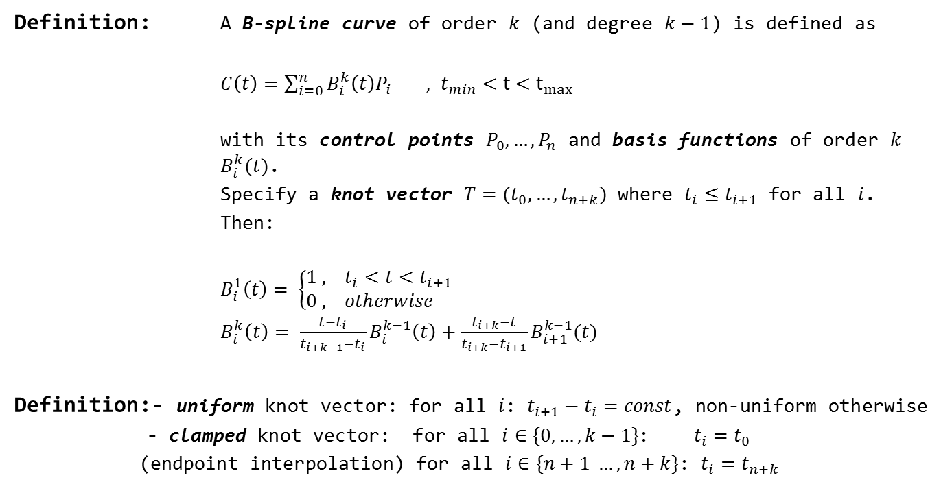
B-splines
Definition: A B-spline curve of order $k$ (and degree $k−1$) is defined as
$C\left(t\right)=\sum_{i=0}^{n}{B_{i}^{k}\left(t\right)P_{i}}$ $, t_{min}<t<t_{max}$
with its control points $P_{0},…, P_{n}$ and basis functions of order $k$ $B_{i}^{k}(t)$.
Specify a knot vector $T=(t_{0},…,t_{n+k})$ where $t_{i}≤t_{i+1}$ for all $i$.
Then:
$B_{i}^{1}\left(t\right)= \left\{\begin{aligned}1 , t_{i}<t<t_{i+1} \\ 0 , otherwise \end{aligned}\right.$
$B_{i}^{k}\left(t\right)= \frac{t−t_{i}}{t_{i+k−1}−t_{i}}B_{i}^{k−1}\left(t\right)+\frac{t_{i+k}−t}{t_{i+k}−t_{i+1}}B_{i+1}^{k−1}(t)$
Definition:- uniform knot vector: for all $i$: $t_{i+1}−t_{i}=const$, non-uniform otherwise
- clamped knot vector: for all $i∈\{0, …, k−1\}$: $t_{i}=t_{0}$
(endpoint interpolation) for all $i∈\{n+1 …, n+k\}$: $t_{i}=t_{n+k}$

Slide 9
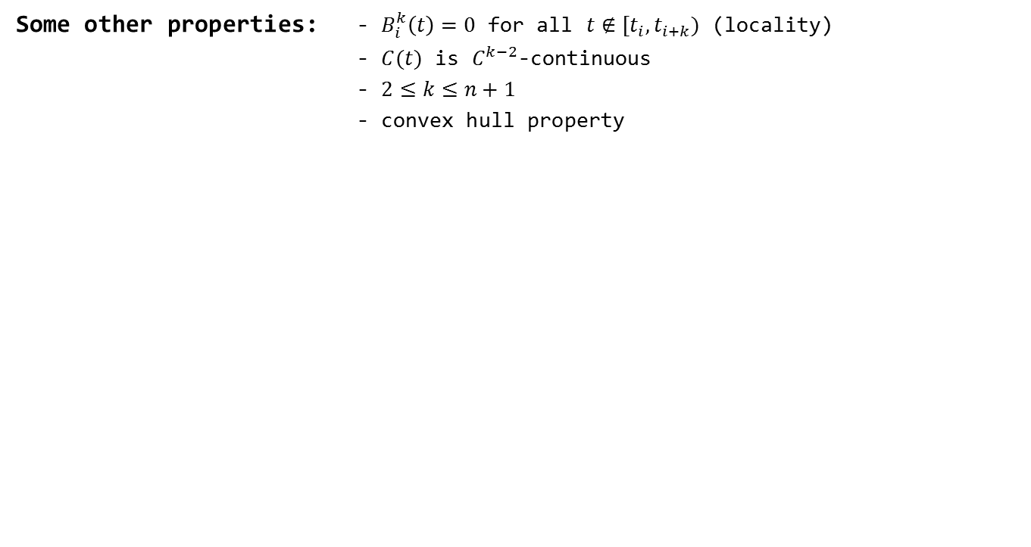
B-splines
Some other properties: - $B_{i}^{k}\left(t\right)=0$ for all $t∉[t_{i}, t_{i+k})$ (locality)
- $C(t)$ is $C^{k−2}$-continuous
- $2≤k≤n+1$
- convex hull property

Slide 10
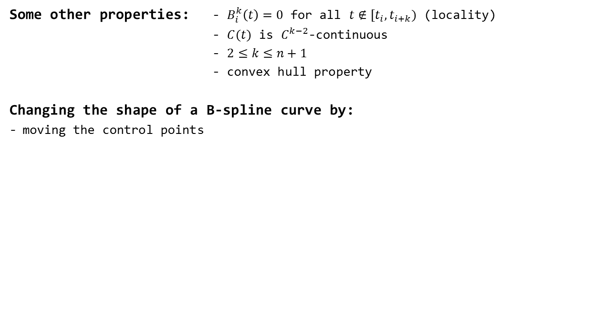
B-splines
Some other properties: - $B_{i}^{k}\left(t\right)=0$ for all $t∉[t_{i}, t_{i+k})$ (locality)
- $C(t)$ is $C^{k−2}$-continuous
- $2≤k≤n+1$
- convex hull property
Changing the shape of a B-spline curve by:
moving the control points

Slide 11
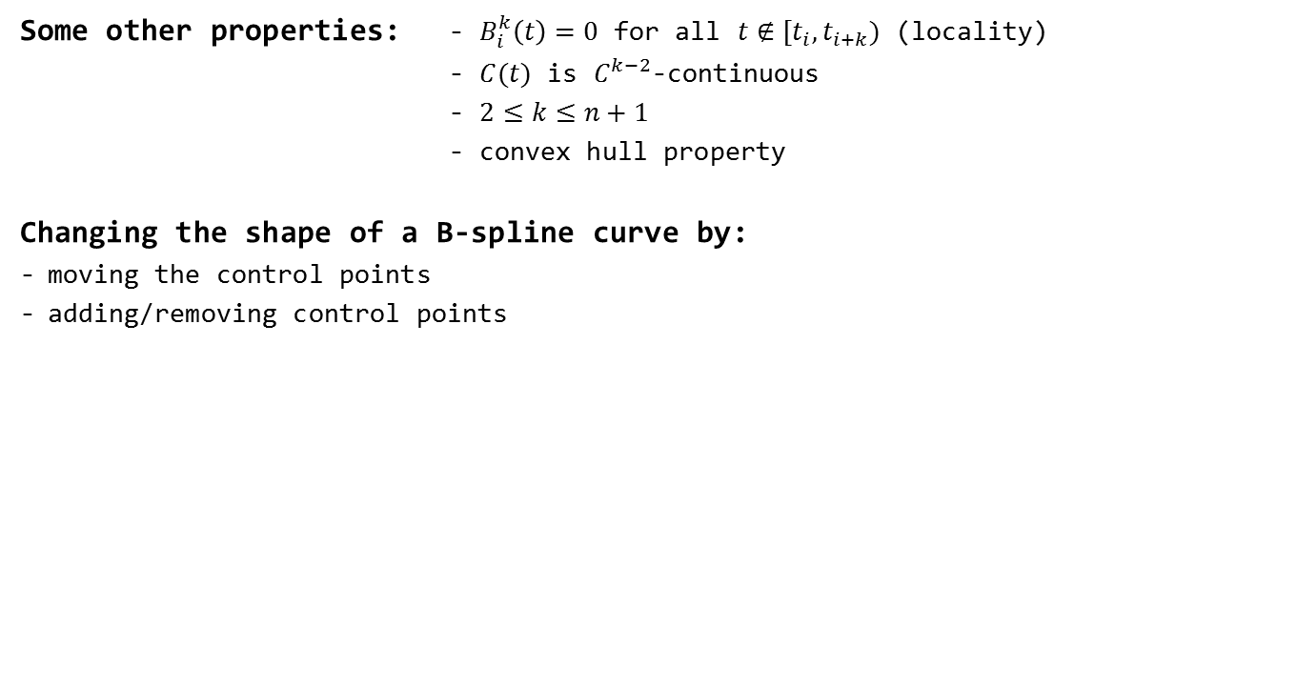
B-splines
Some other properties: - $B_{i}^{k}\left(t\right)=0$ for all $t∉[t_{i}, t_{i+k})$ (locality)
- $C(t)$ is $C^{k−2}$-continuous
- $2≤k≤n+1$
- convex hull property
Changing the shape of a B-spline curve by:
moving the control points
adding/removing control points

Slide 12
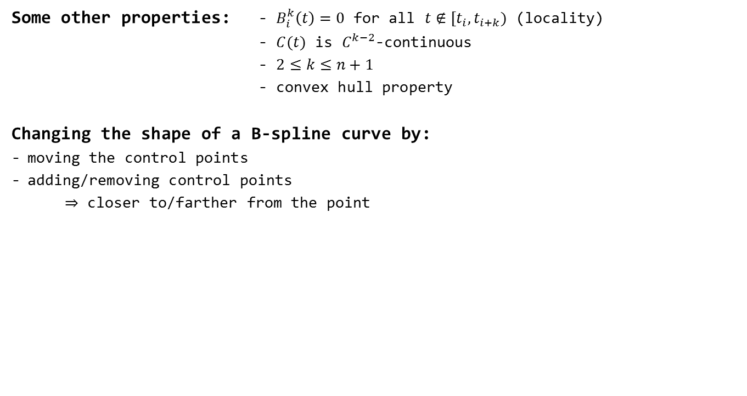
B-splines
Some other properties: - $B_{i}^{k}\left(t\right)=0$ for all $t∉[t_{i}, t_{i+k})$ (locality)
- $C(t)$ is $C^{k−2}$-continuous
- $2≤k≤n+1$
- convex hull property
Changing the shape of a B-spline curve by:
moving the control points
adding/removing control points
$⇒$ closer to/farther from the point

Slide 13
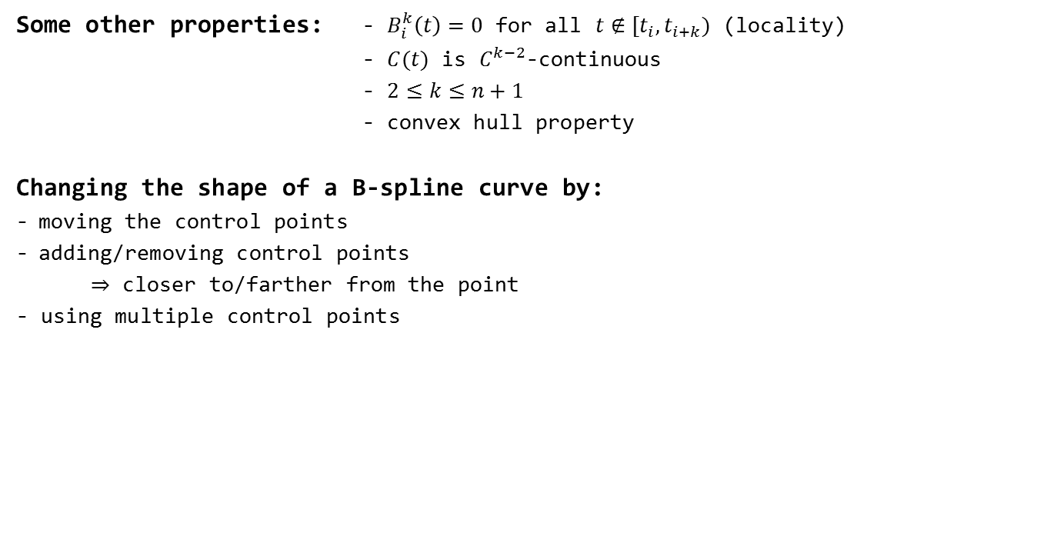
B-splines
Some other properties: - $B_{i}^{k}\left(t\right)=0$ for all $t∉[t_{i}, t_{i+k})$ (locality)
- $C(t)$ is $C^{k−2}$-continuous
- $2≤k≤n+1$
- convex hull property
Changing the shape of a B-spline curve by:
moving the control points
adding/removing control points
$⇒$ closer to/farther from the point
- using multiple control points

Slide 14
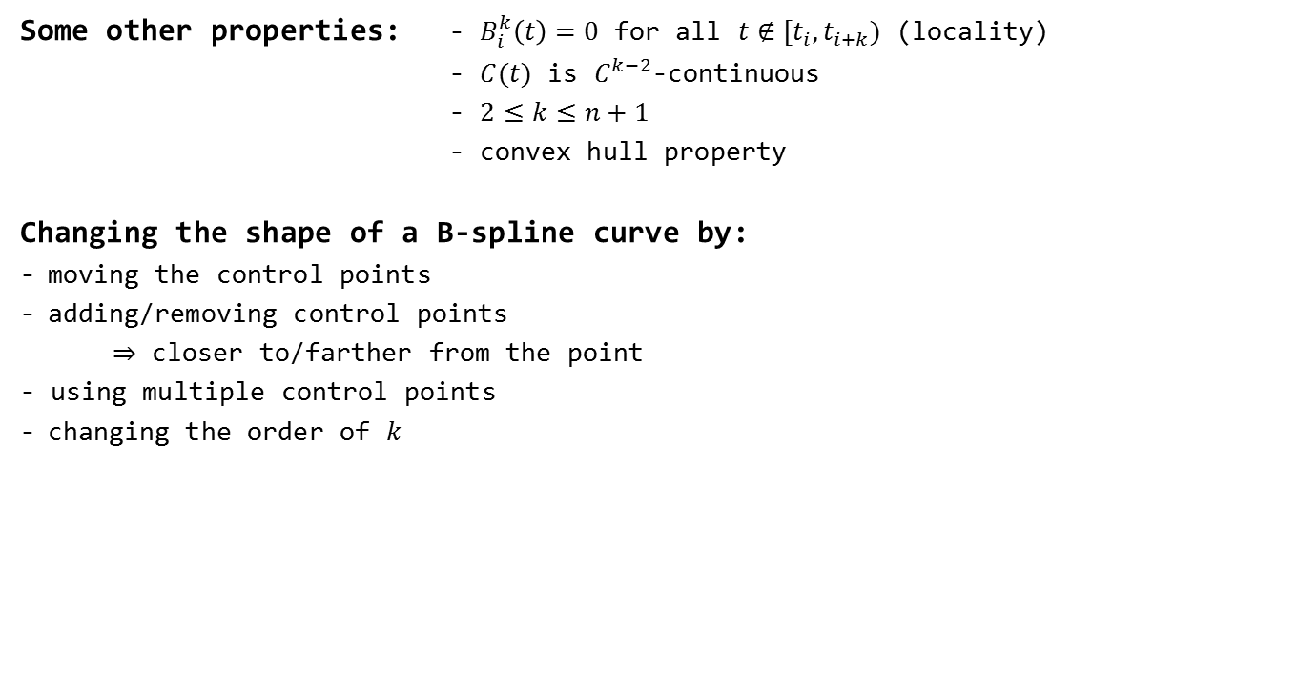
B-splines
Some other properties: - $B_{i}^{k}\left(t\right)=0$ for all $t∉[t_{i}, t_{i+k})$ (locality)
- $C(t)$ is $C^{k−2}$-continuous
- $2≤k≤n+1$
- convex hull property
Changing the shape of a B-spline curve by:
moving the control points
adding/removing control points
$⇒$ closer to/farther from the point
- using multiple control points
changing the order of $k$

Slide 15
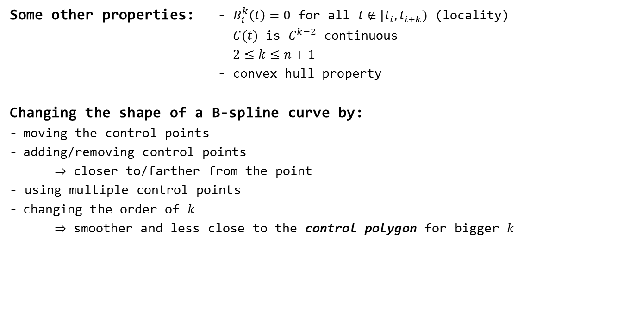
B-splines
Some other properties: - $B_{i}^{k}\left(t\right)=0$ for all $t∉[t_{i}, t_{i+k})$ (locality)
- $C(t)$ is $C^{k−2}$-continuous
- $2≤k≤n+1$
- convex hull property
Changing the shape of a B-spline curve by:
moving the control points
adding/removing control points
$⇒$ closer to/farther from the point
- using multiple control points
changing the order of $k$
$⇒$ smoother and less close to the control polygon for bigger $k$

Slide 16
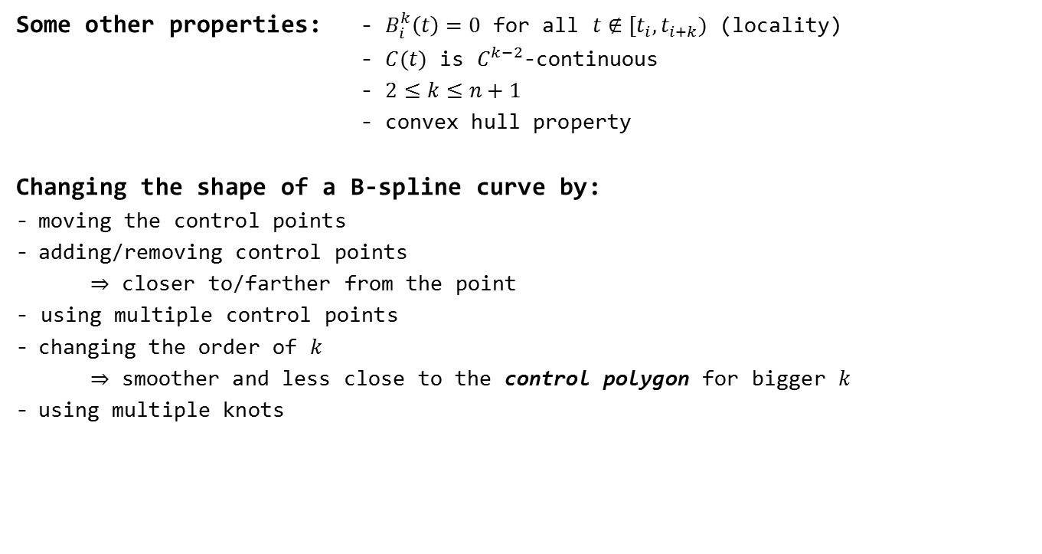
B-splines
Some other properties: - $B_{i}^{k}\left(t\right)=0$ for all $t∉[t_{i}, t_{i+k})$ (locality)
- $C(t)$ is $C^{k−2}$-continuous
- $2≤k≤n+1$
- convex hull property
Changing the shape of a B-spline curve by:
moving the control points
adding/removing control points
$⇒$ closer to/farther from the point
- using multiple control points
changing the order of $k$
$⇒$ smoother and less close to the control polygon for bigger $k$
using multiple knots

Slide 17
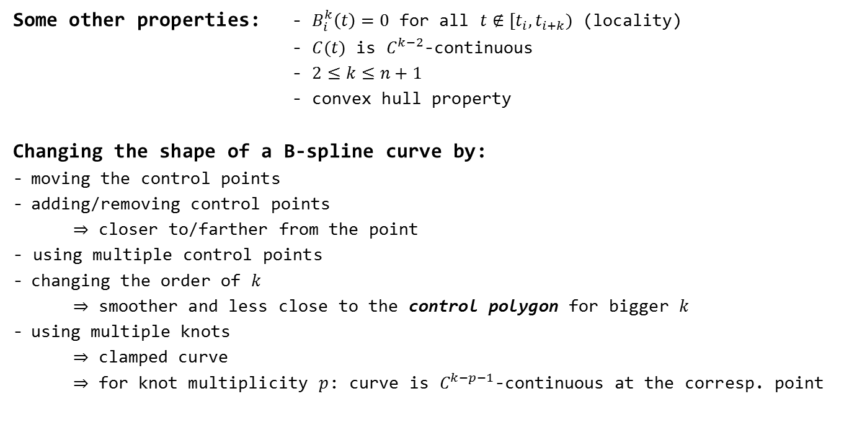
B-splines
Some other properties: - $B_{i}^{k}\left(t\right)=0$ for all $t∉[t_{i}, t_{i+k})$ (locality)
- $C(t)$ is $C^{k−2}$-continuous
- $2≤k≤n+1$
- convex hull property
Changing the shape of a B-spline curve by:
moving the control points
adding/removing control points
$⇒$ closer to/farther from the point
- using multiple control points
changing the order of $k$
$⇒$ smoother and less close to the control polygon for bigger $k$
using multiple knots
$⇒$ clamped curve
$⇒$ for knot multiplicity $p$: curve is $C^{k−p−1}$-continuous at the corresp. point

Slide 18
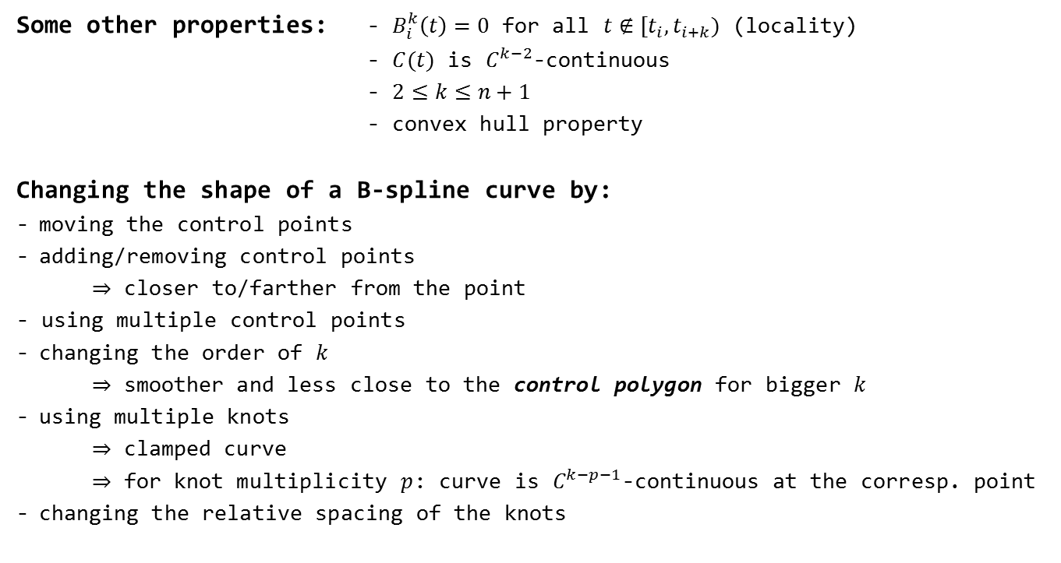
B-splines
Some other properties: - $B_{i}^{k}\left(t\right)=0$ for all $t∉[t_{i}, t_{i+k})$ (locality)
- $C(t)$ is $C^{k−2}$-continuous
- $2≤k≤n+1$
- convex hull property
Changing the shape of a B-spline curve by:
moving the control points
adding/removing control points
$⇒$ closer to/farther from the point
- using multiple control points
changing the order of $k$
$⇒$ smoother and less close to the control polygon for bigger $k$
using multiple knots
$⇒$ clamped curve
$⇒$ for knot multiplicity $p$: curve is $C^{k−p−1}$-continuous at the corresp. point
changing the relative spacing of the knots

Slide 19
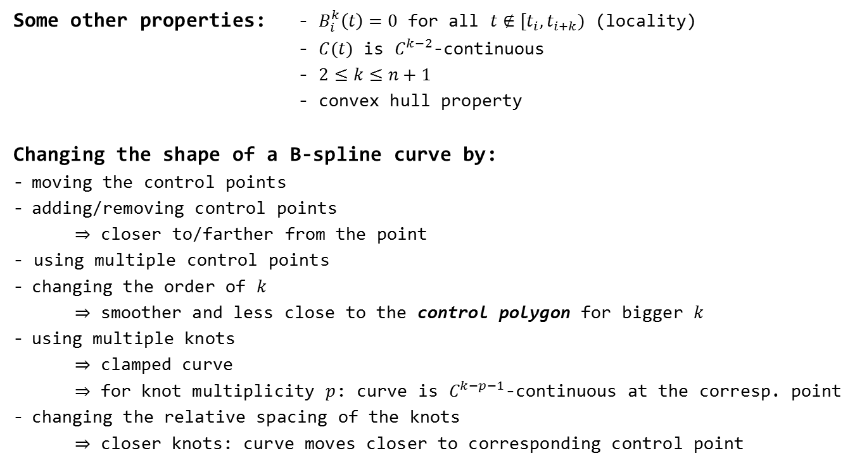
B-splines
Some other properties: - $B_{i}^{k}\left(t\right)=0$ for all $t∉[t_{i}, t_{i+k})$ (locality)
- $C(t)$ is $C^{k−2}$-continuous
- $2≤k≤n+1$
- convex hull property
Changing the shape of a B-spline curve by:
moving the control points
adding/removing control points
$⇒$ closer to/farther from the point
- using multiple control points
changing the order of $k$
$⇒$ smoother and less close to the control polygon for bigger $k$
using multiple knots
$⇒$ clamped curve
$⇒$ for knot multiplicity $p$: curve is $C^{k−p−1}$-continuous at the corresp. point
changing the relative spacing of the knots
$⇒$ closer knots: curve moves closer to corresponding control point

Slide 20
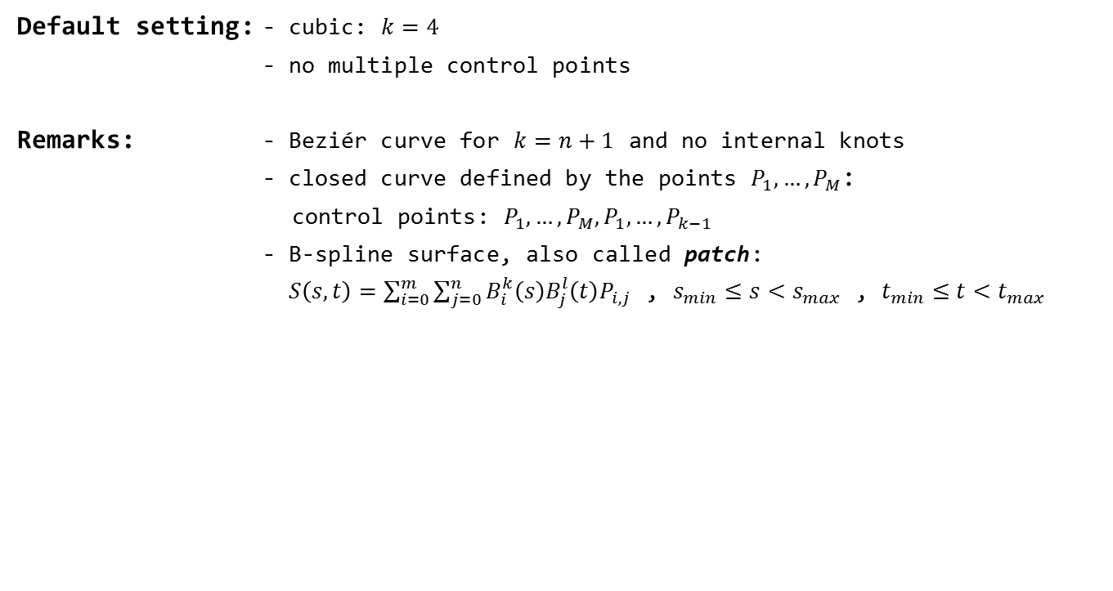
B-splines
Default setting: - cubic: $k=4$
- no multiple control points
Remarks: - Beziér curve for $k=n+1$ and no internal knots
- closed curve defined by the points $P_{1},…, P_{M}$:
control points: $P_{1},…, P_{M}, P_{1}, …, P_{k−1}$
- B-spline surface, also called patch:
$S\left(s, t\right)=\sum_{i=0}^{m}{\sum_{j=0}^{n}{B_{i}^{k}\left(s\right)B_{j}^{l}\left(t\right)P_{i, j}}}$ , $s_{min}≤s<s_{max}$ , $t_{min}≤t<t_{max}$

Slide 21
Mathematical Theory of Gordon Surfaces

Slide 22
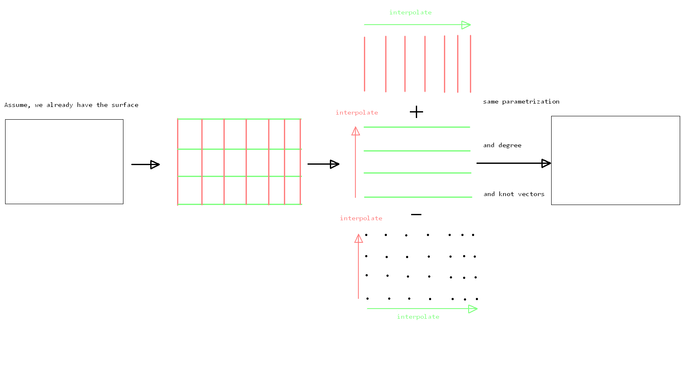
Gordon Surfaces

Slide 23
Steps for Creating the Gordon Surface in Detail

Slide 24
Main Steps
Reparametrization of B-spline curves
Creating a common knot vector for B-spline curves and surfaces
Degree elevation for B-spline curves and surfaces
Knot insertion for B-spline curves and surfaces
Finding the intersection points of the curve network
Creating the two skinned surfaces
Creating tensor product surface
Creating the Gordon Surface

Slide 25
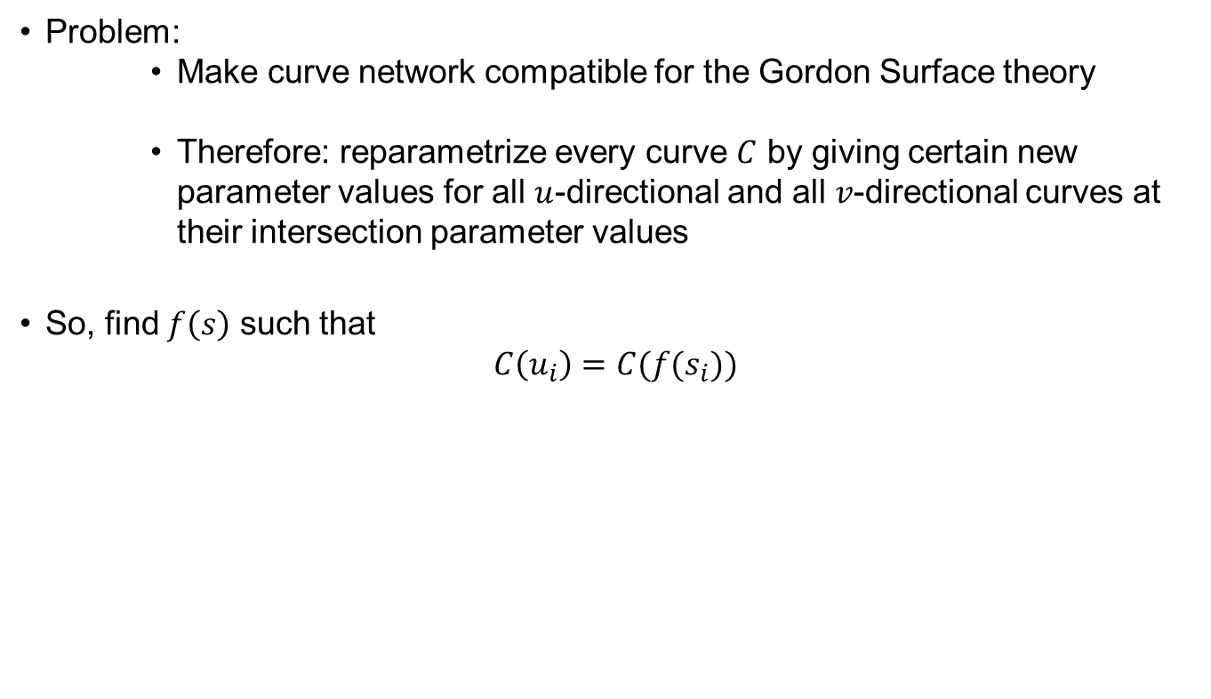
$C^{1}$-Continuous B-spline Curve Reparametrization
Problem:
Make curve network compatible for the Gordon Surface theory
Therefore: reparametrize every curve $C$ by giving certain new parameter values for all $u$-directional and all $v$-directional curves at their intersection parameter values
So, find $f\left(s\right)$ such that
$$C\left(u_{i}\right)=C(f(s_{i}))$$

Slide 26
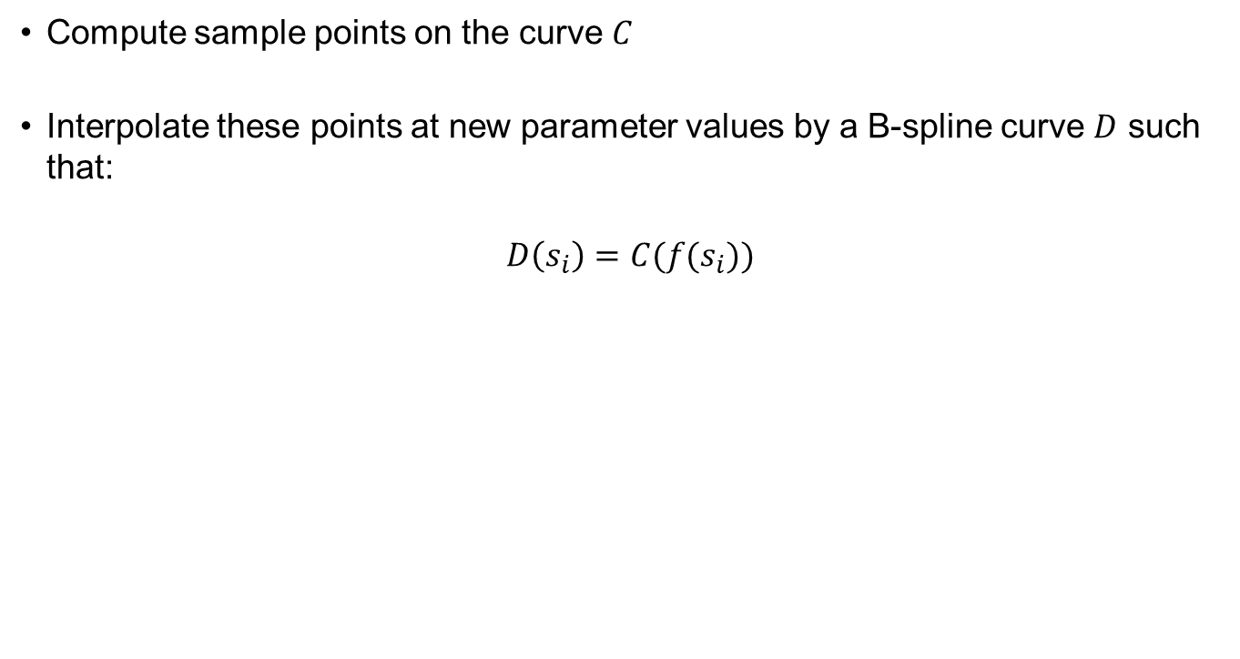
$C^{1}$-Continuous B-spline Curve Reparametrization
Compute sample points on the curve $C$
Interpolate these points at new parameter values by a B-spline curve $D$ such that:
$$D\left(s_{i}\right)=C(f(s_{i}))$$

Slide 27
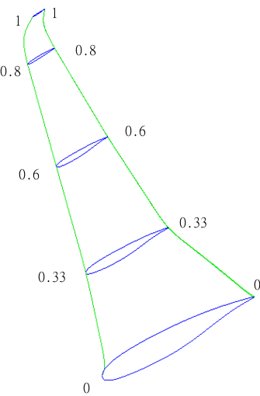
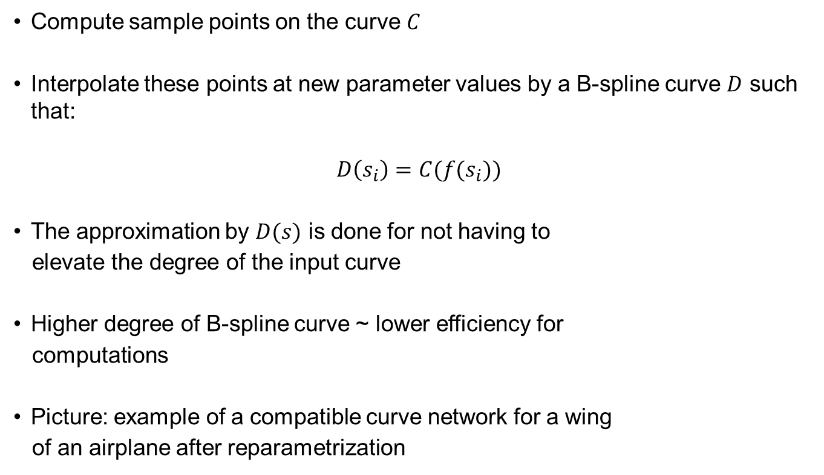
$C^{1}$-Continuous B-spline Curve Reparametrization
Compute sample points on the curve $C$
Interpolate these points at new parameter values by a B-spline curve $D$ such that:
$$D\left(s_{i}\right)=C(f(s_{i}))$$
The approximation by $D(s)$ is done for not having to
elevate the degree of the input curve
Higher degree of B-spline curve ~ lower efficiency for
computations
Picture: example of a compatible curve network for a wing
of an airplane after reparametrization

Slide 28
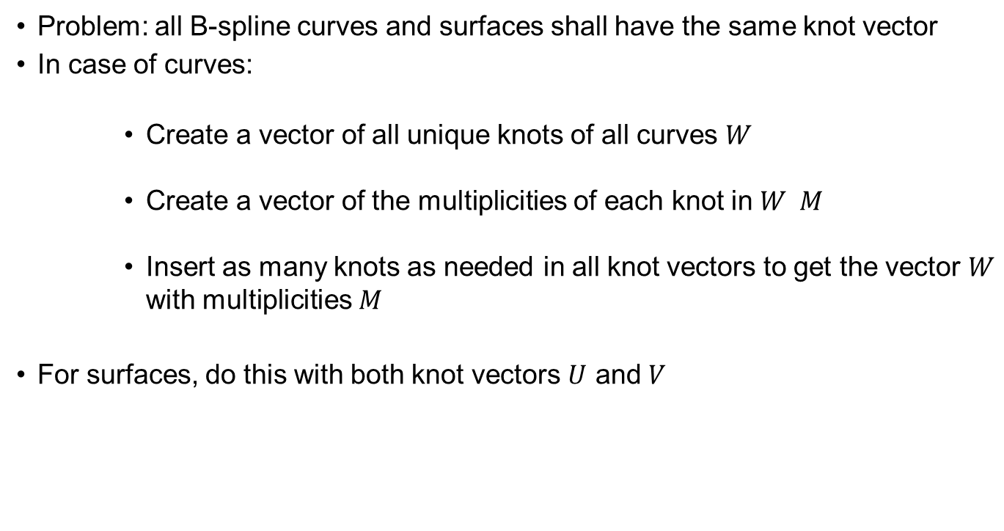
Creating a Common Knot Vector
Problem: all B-spline curves and surfaces shall have the same knot vector
In case of curves:
Create a vector of all unique knots of all curves $W$
Create a vector of the multiplicities of each knot in $W M$
Insert as many knots as needed in all knot vectors to get the vector $W$ with multiplicities $M$
For surfaces, do this with both knot vectors $U$ and $V$

Slide 29
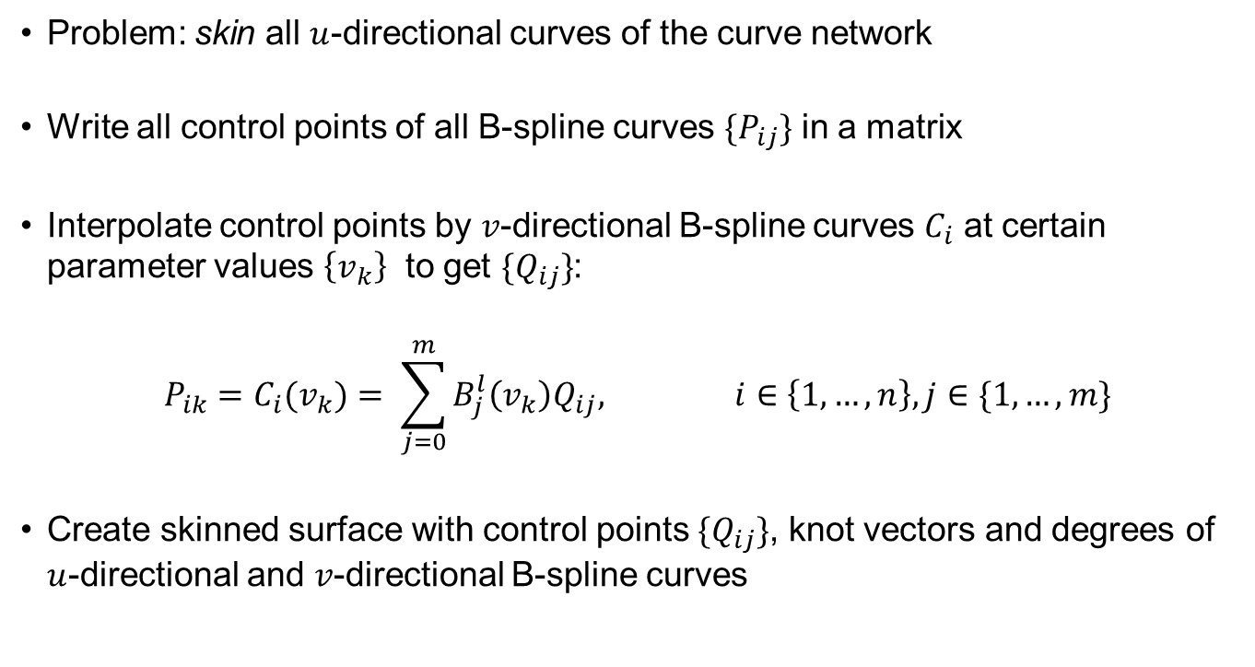
Creating the Skinned Surfaces
Problem: skin all $u$-directional curves of the curve network
Write all control points of all B-spline curves $\{P_{ij}\}$ in a matrix
Interpolate control points by $v$-directional B-spline curves $C_{i}$ at certain parameter values $\left\{v_{k}\right\}$ to get $\{Q_{ij}\}$:
$$P_{ik}=C_{i}{(v}_{k})= \sum_{j=0}^{m}{B_{j}^{l}\left(v_{k}\right)Q_{ij}, i∈\left\{1, …, n\right\}, j∈\{1, …, m\}}$$
Create skinned surface with control points $\{Q_{ij}\}$, knot vectors and degrees of $u$-directional and $v$-directional B-spline curves

Slide 30
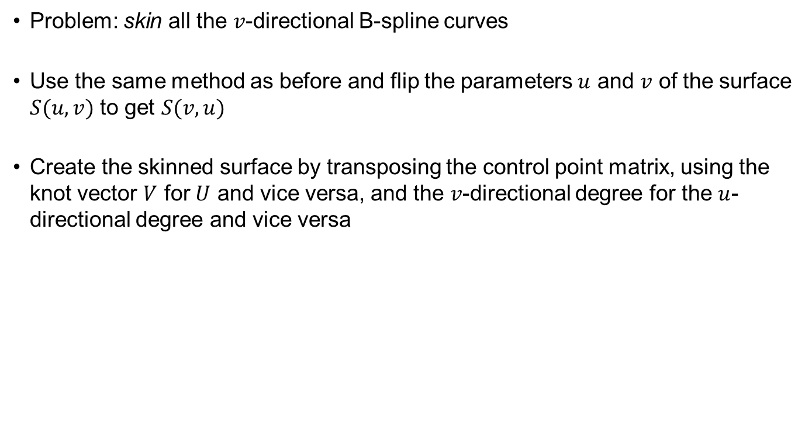
Creating the Skinned Surfaces
Problem: skin all the $v$-directional B-spline curves
Use the same method as before and flip the parameters $u$ and $v$ of the surface $S(u, v)$ to get $S(v, u)$
Create the skinned surface by transposing the control point matrix, using the knot vector $V$ for $U$ and vice versa, and the $v$-directional degree for the $u$-directional degree and vice versa

Slide 31
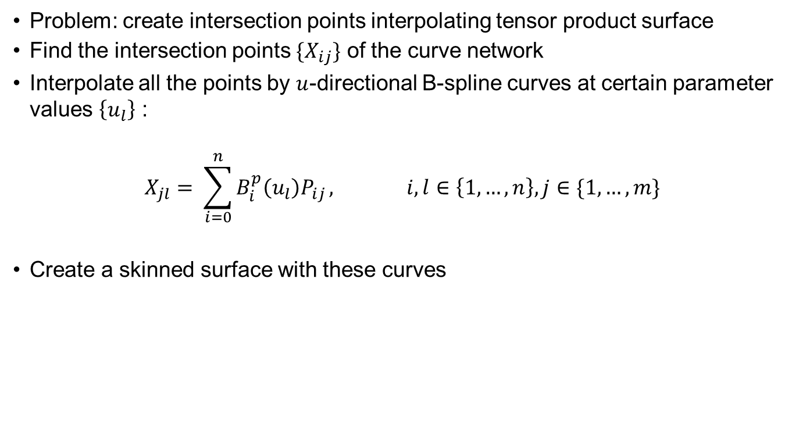
Creating the Tensor Product Surface
Problem: create intersection points interpolating tensor product surface
Find the intersection points $\{X_{ij}\}$ of the curve network
Interpolate all the points by $u$-directional B-spline curves at certain parameter values $\left\{u_{l}\right\}$ :
$$X_{jl}= \sum_{i=0}^{n}{B_{i}^{p}\left(u_{l}\right)P_{ij}}, i,l∈\left\{1, …, n\right\}, j∈\{1, …, m\}$$
Create a skinned surface with these curves

Slide 32
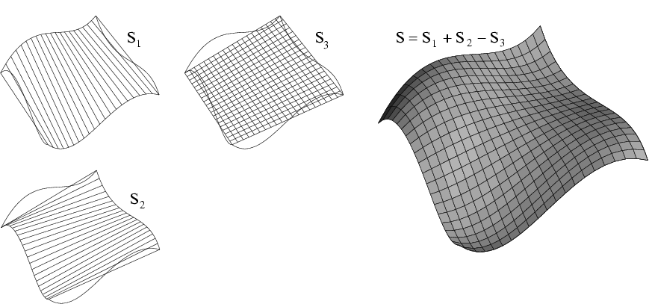
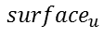
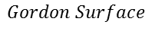
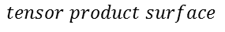
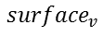
Finally: Creating the Gordon Surface
Making the curve network compatible by reparametrization
Get common degree and knot vector of the curves in the two directions
Find the intersection points and their parameters
Create the two skinned surfaces with these parameters
Create the tensor product surface with these parameters
Create common knot vector for these three surfaces
Create B-spline Gordon Surface by superposing the corresponding control points of the three surfaces (this way B-spline surfaces are superposed)
$$Gordon Surface$$
$${surface}_{u}$$
$$tensor product surface$$
$${surface}_{v}$$

Slide 33
Results

Slide 34
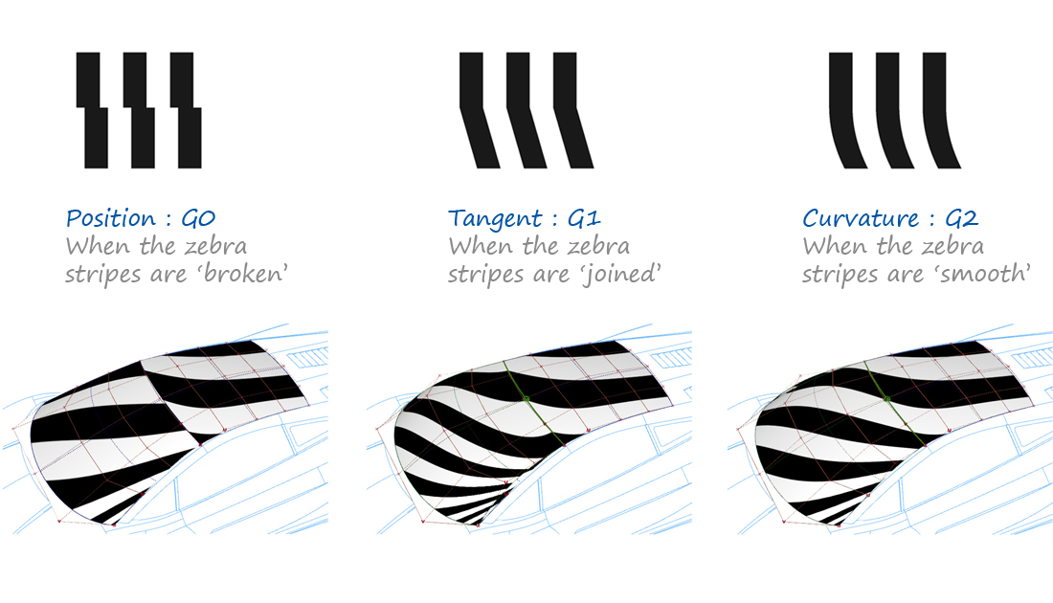
Zebra Stripe Plot
Surface quality analysis with zebra stripe plot (in TiGL Viewer 3)

Slide 35
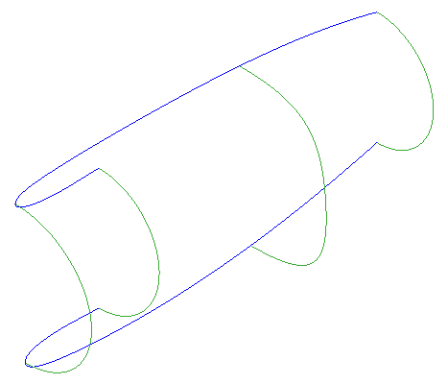
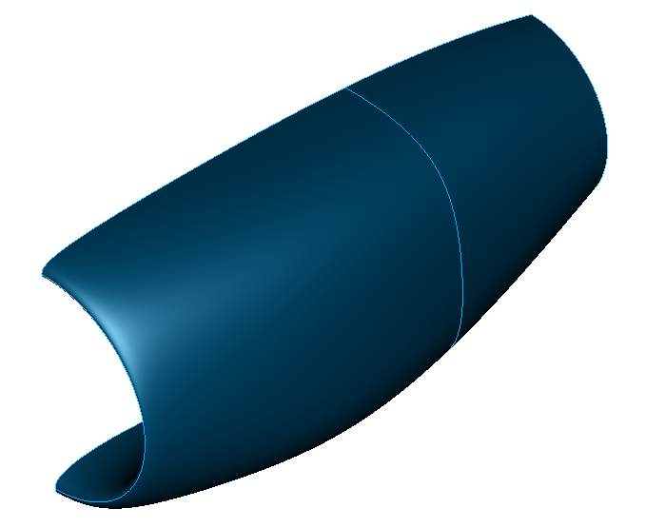
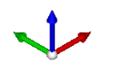
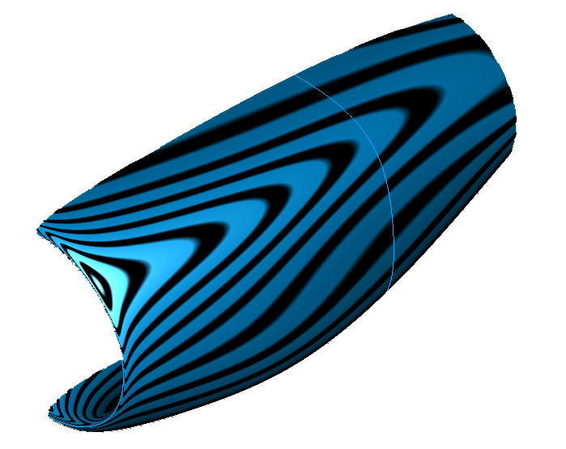
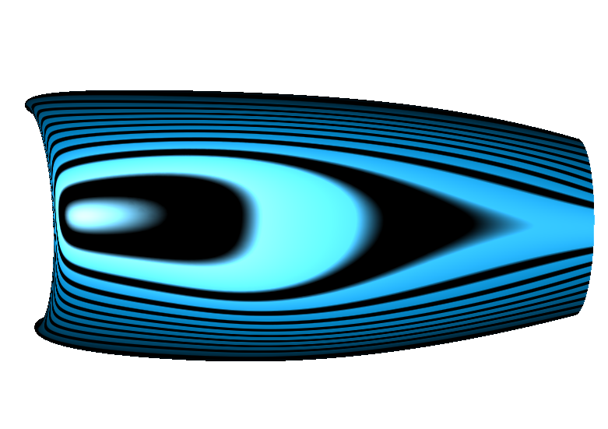
Gordon Surfaces: Results for a Nacelle

Slide 36
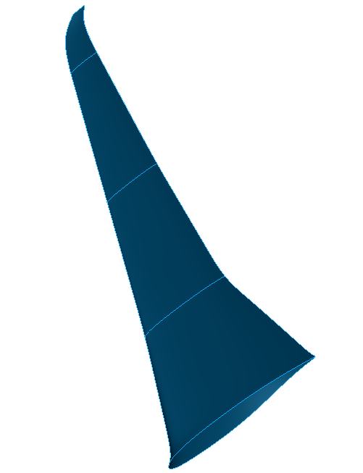
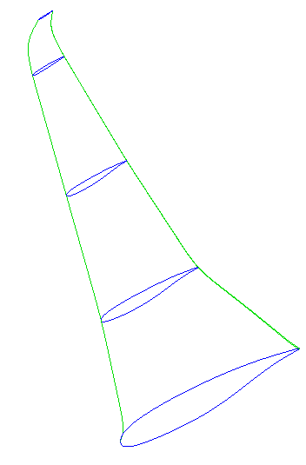

Gordon Surfaces: Results for a Wing

Slide 37
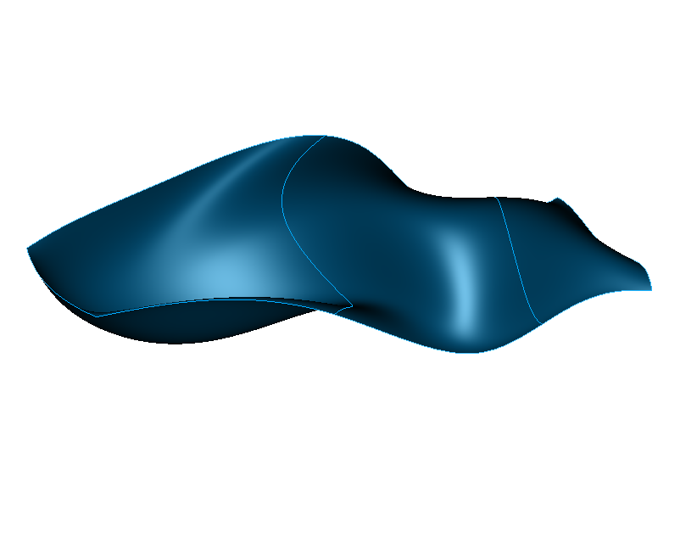
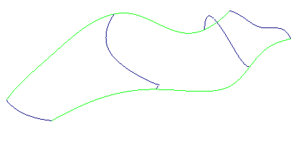
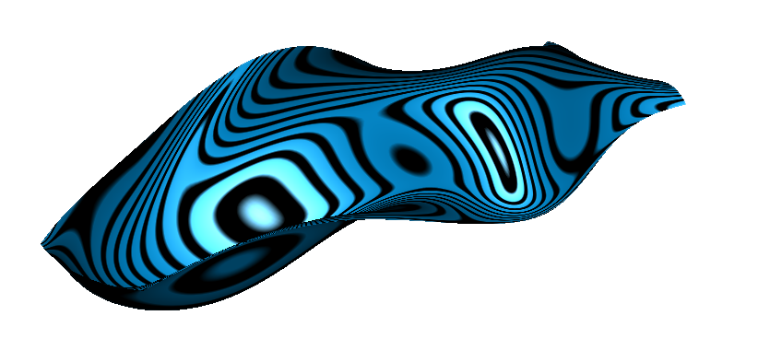
Gordon Surfaces: Results for a General Surface

Slide 38
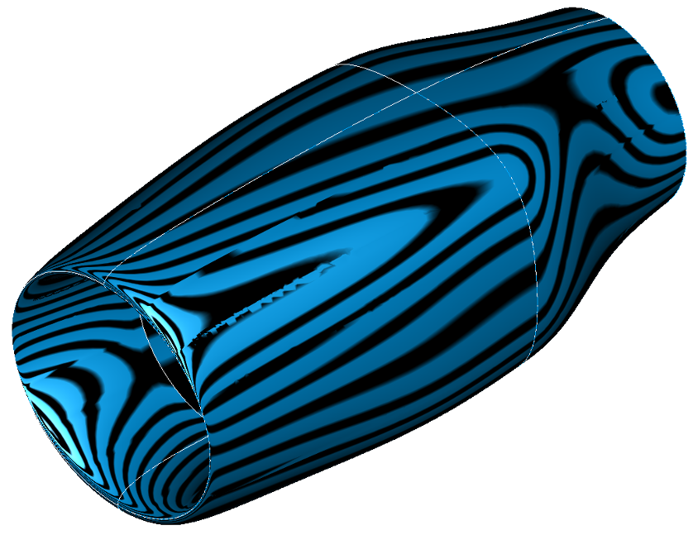
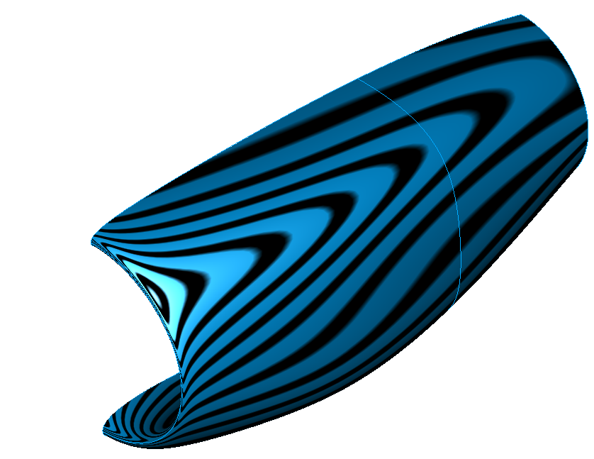
Comparison of Coons and Gordon: Nacelle
Coons Patches
Gordon Surface
(one half of the same nacelle)

Slide 39
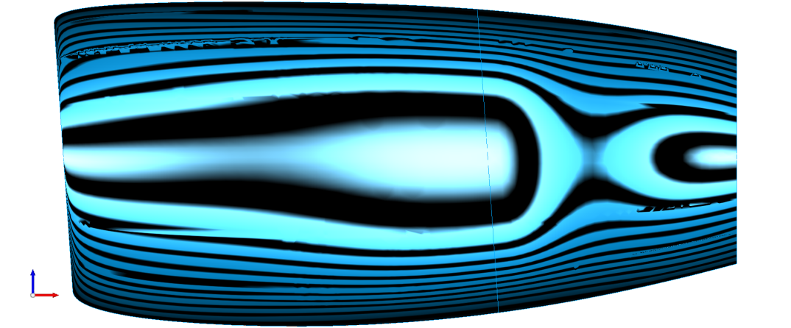
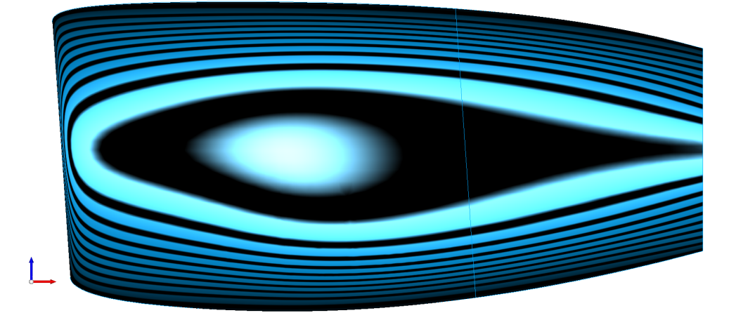
Comparison of Coons and Gordon: Nacelle
Coons Patches
Gordon Surface

Slide 40
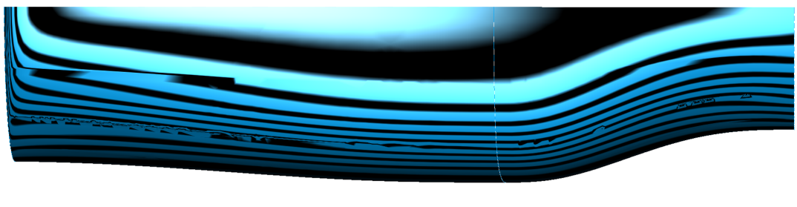
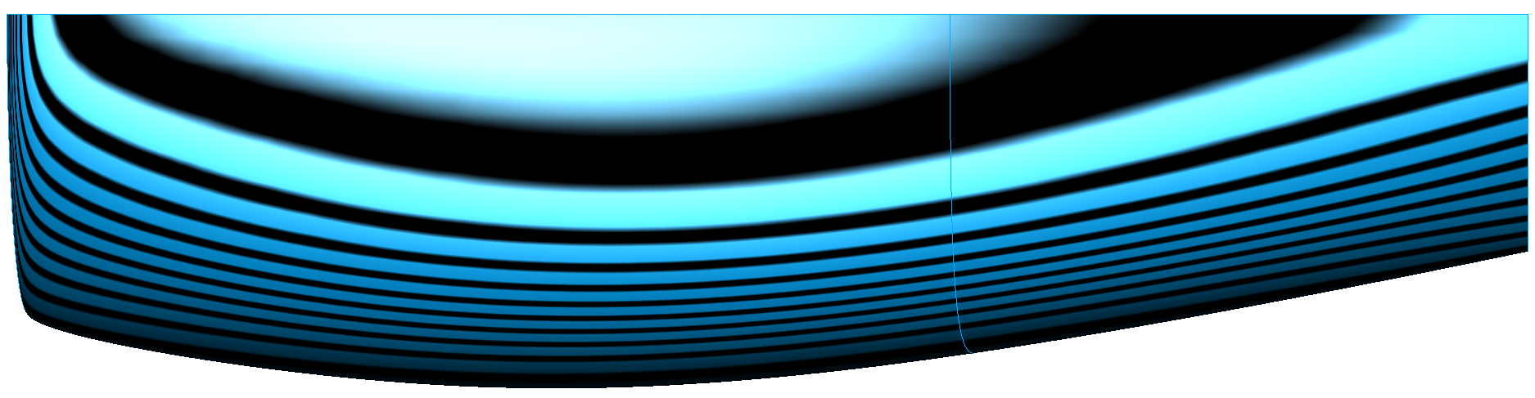
Comparison of Coons and Gordon: Nacelle
Coons Patches
Gordon Surface

Slide 41
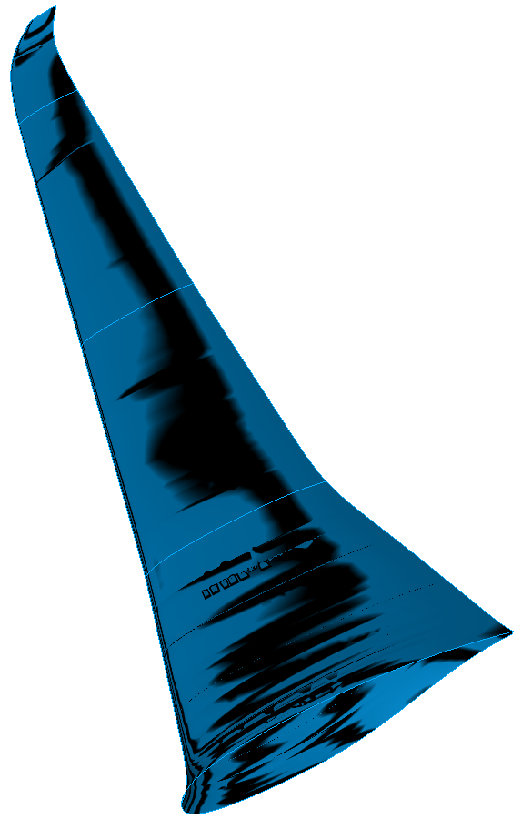
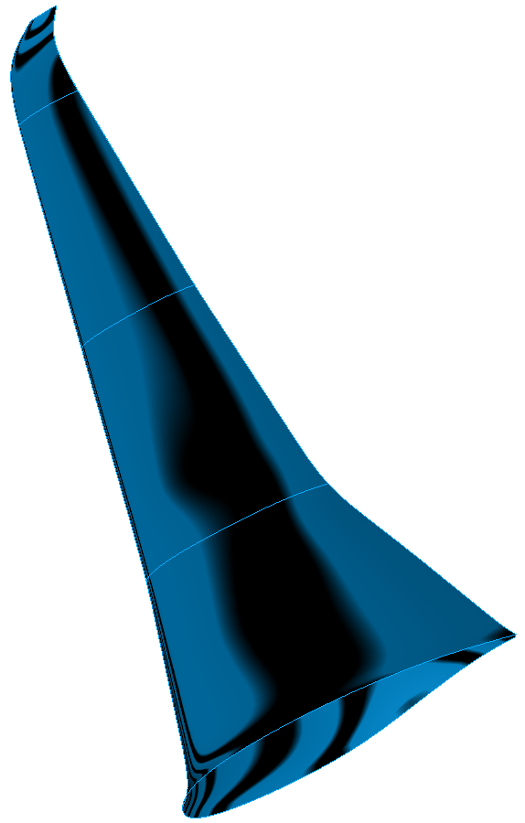
Comparison of Coons and Gordon: Wing
Coons Patches
Gordon Surface

Slide 42

Comparison of Coons and Gordon: Wing
Coons Patches

Slide 43

Comparison of Coons and Gordon: Wing
Gordon Surface

Slide 44


Comparison of Coons and Gordon: Wing
Coons Patches
Gordon Surface

Slide 45


Comparison of Coons and Gordon: General Surface
Coons Patches
Gordon Surface

Slide 46


Comparison of Coons and Gordon: General Surface
Coons Patches
Gordon Surface

Slide 47
Summary

Slide 48
Summary
Gordon Surface method was presented
Curve reparametrization is crucial→ compatible curve network
Results:
all the previous problems are eliminated now
but: because of global interpolation oscillations might occur
solution: different reparametrization

Slide 49

My Current Work at SR-FLS

Slide 50

My Current Work at SR-FLS

Slide 51

My Current Work at SR-FLS

Slide 52

My Current Work at SR-FLS

Slide 53
References
University of Cambridge, Department of Computer Science and Technology, https://www.cl.cam.ac.uk/teaching/2000/AGraphHCI/SMEG/
Les Piegl and Wayne Tiller: The NURBS book, Springer Science & Business Media, 2012
opencascade.com
Mathematical Theory of Gordon Surfaces:
William J Gordon: Spline-blended surface interpolation through curve networks, Journal of Mathematics and Mechanics, pages 931–952, 1969.

Slide 54
Thank you! ☺

Slide 55

Degree Elevation
Problem: the B-spline curve or surface shall have a higher degree
Knot vector before:
$$U=\{\underset{ k times}{\underbrace{u_{0}, …, u_{0}},}\underset{m_{1} times}{\underbrace{u_{1}, …, u_{1}}}, …,\underset{m_{s} times}{\underbrace{u_{s}, …, u_{s}}}, \underset{k times}{\underbrace{u_{n}, …, u_{n}}}\}$$
Knot vector afterwards:
$$\hat{U}=\{\underset{k+1 times}{\underbrace{u_{0}, …, u_{0}},}\underset{m_{1}+1 times}{\underbrace{u_{1}, …, u_{1}}}, …,\underset{m_{s}+1 times}{\underbrace{u_{s}, …, u_{s}}}, \underset{k+1 times}{\underbrace{u_{n}, …, u_{n}}}\}$$
The new control points are computed by evaluating the basis functions at certain $\hat{n}+1$ parameter values and solving:
$$\sum_{i=0}^{\hat{n}}{B_{i}^{k+1}\left(u\right)Q_{i}}= \sum_{i=0}^{n}{B_{i}^{k}(u)P_{i}}$$

Slide 56

Knot Insertion
Problem: insert knot $\overline{u}$in the knot vector after the knot with index $l$
New formula of the curve:
$C\left(u\right)= \sum_{i=0}^{n+1}{{\overline{B}}_{i}^{k}(u)Q_{i}}$
The new control points $Q_{i}$ are computed by:
$$Q_{i}= α_{i}P_{i}+\left(1−α_{i}\right)P_{i−1}, where α_{i}= \left\{\begin{aligned}1, i≤l−k \\ \frac{\overline{u}−u_{i}}{u_{i+k}−u_{i}}, l−k+1≤i≤l \\ 0, i≥l+1\end{aligned}\right.$$
Knot insertion for B-spline surfaces analogue for both knot vectors $U$ and $V$

